Slide 1
Foreseeing the severity of the collision in Seattle

Slide 2
Data Set of Seattle department of Transport (SDOT)
Looking into human factors, external factors, collision site details and time series
Understanding factors that influence the collision can help minimize accidents on the road
Contains data from 2004-2020

Slide 3
DATA cleaning & Feature selection
Removing 2020 data
Replacing missing data
Creating ‘Hour’, ‘Week Day’, ‘Month’ columns
Combining categories to simplify information
There are only 2 types of severity levels in the data set
Under Influence, Unattention, Light Conditions, Weather, Address Type, Road Conditions

Slide 4
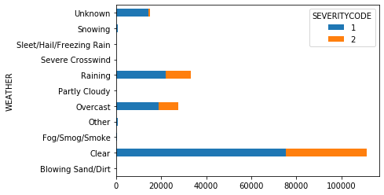
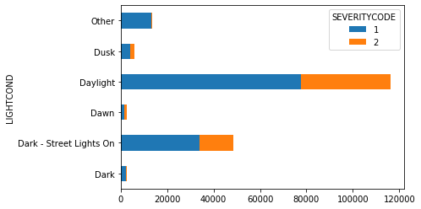
Exploratory analyses
External Factor:
Weather and Light Condition
Weather is similar graph as Road Conditions
More traffic on clear day?
Rain is the second largest
Night with the lights on second category

Slide 5
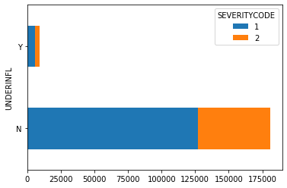
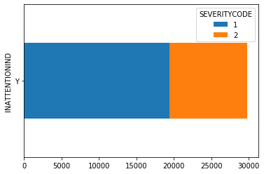
Exploratory analysis
Human Factor:
Under influence and Not Paying Attention
Some data not available
No clear indication

Slide 6
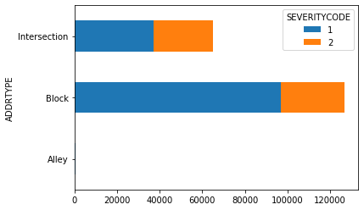
Exploratory analyses
Collision site characteristics:
Address Type
Gives three clear category

Slide 7
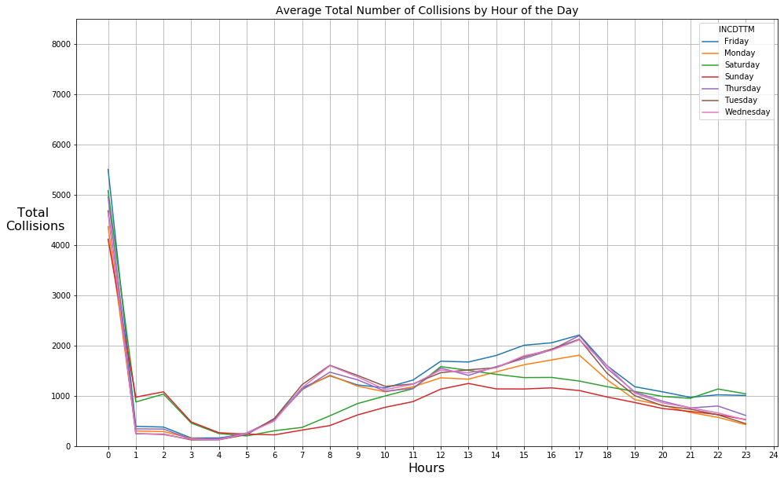
Exploratory Analyses
Time series analyses:
Time of the Day
Highest rate is at midnight
Also most of the accidents happen on Friday during the week and in the month of October

Slide 8
Predictive modelling
Classification supervised learning to predict the severity of the collision based on the input factors
KNN
Decision Tree
SVM
Logistic Regression
Accuracy table
Algorithm | Jaccard | F1-score | LogLoss
KNN | 0.67 | 0.64 | NA
Decision Tree | 0.7 | 0.59 | NA
SVM | 0.7 | 0.58 | NA
Logistic Regression | 0.7 | 0.59 | 0.59

Slide 9
Results & conclusion
The highest accuracy rate for classification is 0.7 using SVM, Decision Tree and logistic regression
Limited available data
New technology to be considered

